Slide 1
1.6 Applications of Linear Systems

Slide 2
Applications
Economics
Chemistry
Network flow

Slide 3
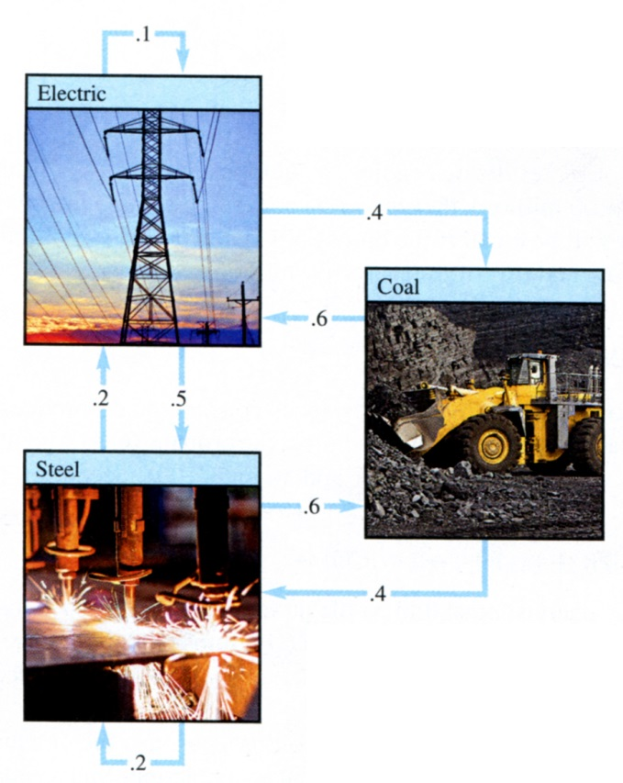
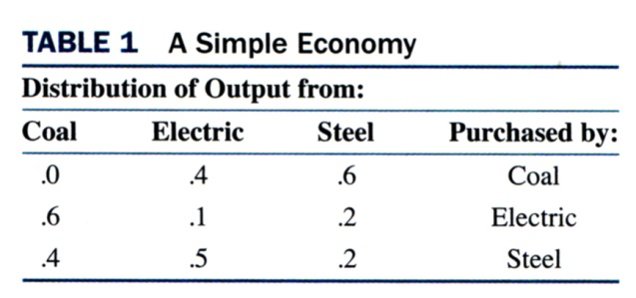
A Homogeneous System in Economics
Leontief “input-output” model

Slide 4
p_{C}=.4p_{E}+.6p_{S}
p_{E}=.6p_{C} +.1p_{E}+.2p_{S}
p_{S}=.4p_{C} +.5p_{E}+.2p_{S}

Slide 5
Balancing Chemical Equations
(x1)C₃H₈+(x2)O₂ → (x3)CO₂+(x4)H₂O

Slide 6
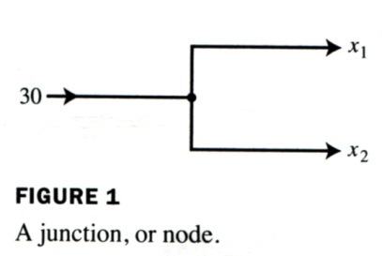
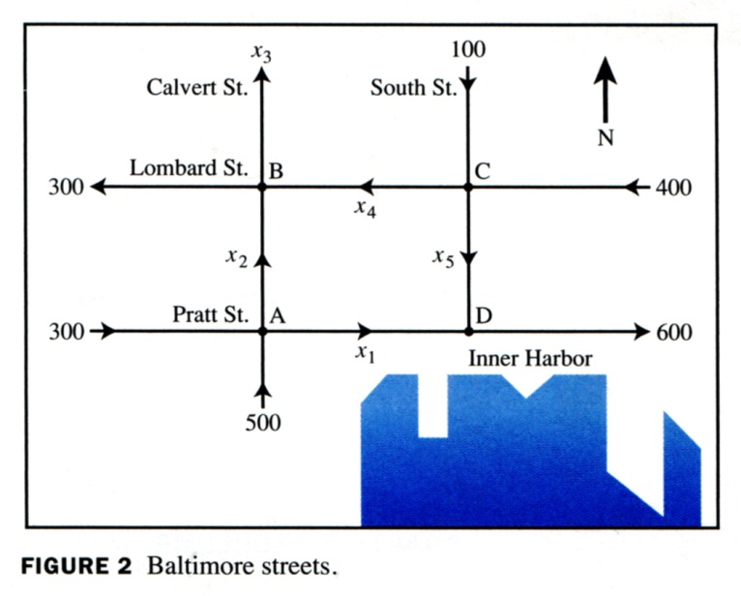
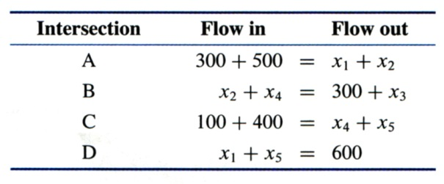
Network Flow

